Slide 1
Ant System (AS) for TSP
m is the number of ants
τ_{ij}(t) is the intensity of pheromone on the link (i, j) in time t
°
°
°
Problem: Given n cities, the goal is to find the shortest path going
through all cities and visiting each exactly once.
Consider complete graph.
°
^{d}ij
is Euclidean distance from city i to city j
Definition
^{η}ij
is visibility (heuristic information) expressed by 1/d_{ij}
(1-ρ) evaporation factor, ρ is constant for the whole opt. process
tabu_{k} is dynamically growing vector of cities that have already been
visited by k-th ant
AS iteration - each ant adds one city to the built route
AS cycle – composed of n iterations during which all ants complete
their routes

Slide 2
AS: Pheromone Deposition
• τij(t+n) = ρ⋅τij(t) +Δτij
Δτij = ∑_{k} Δτij^{k}
Q/L_{k}, if k-th ant used the edge (i, j)
Δτij^{k} =
0, otherwise.
where
Δτij^{k} is the amount of pheromone deposited on the edge (i, j) by
k-th ant within a time interval (t, t+n)
Q is a constant
L_{k} is the length of the route constructed by k-th ant
ρ must be smaller than 1, otherwise the pheromone would
accumulate unboundedly (recommended is 0.5)
τij(0) is set to small positive values

Slide 3
AS: Probabilistic Decision Making
Probability of adding a link i-j (where j∈{N - tabu_{k}}) into the route
[τij(t)]^{α}⋅[ηij ]^{β} / ∑_{l}[τij(t)]^{α}⋅[ηij ]^{β} , if j∈{N - tabu_{k}}
p_{ij}^{k}(t) =
0, otherwise.
where
l∈{N - tabu_{k}}
α, β define relative importance of the pheromone and the visibility
Probability is a compromise between
visibility that prefers closer cities to more distant ones and
intensity of pheromone that prefers more frequently used edges.

Slide 4
AS: Cycle
Ant-cycle:
Initialization
time: t=0
number of cycles: NC=0
pheromone: τij(t)=c
Initial positioning of m ants to n cities
Initialization of tabu lists
Ants’ action
Each ant iteratively builds its route
Calculate length of the routes L_{k} for all ants k∈(1,...,m)
update the shortest route found
Calculate Δτij^{k} and update τij(t+n)
Increment discrete time
t = t+n, NC = NC+1
If(NC < NC_{max}) then goto step 2
else stop

Slide 5
AS: Elitism
Intensity of pheromone is strengthened on edges that lie on the
shortest path out of all generated paths
Amount of added pheromone: e ⋅ Q/L* ,
where e is a number of „elite“ ants and L* is the shortest path
Beware of premature convergence.

Slide 6
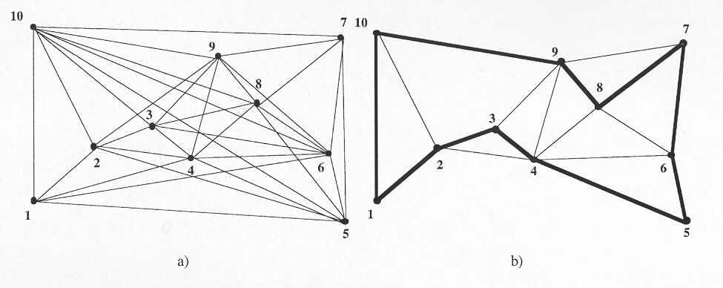
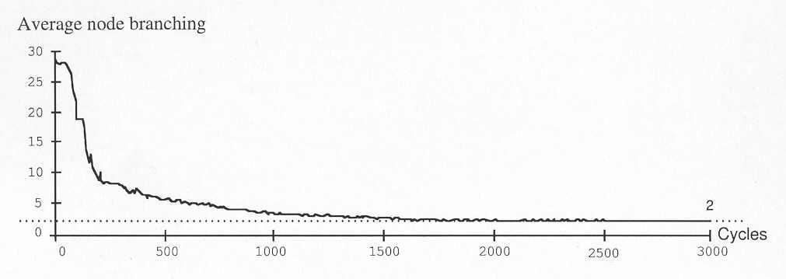
AS: Evolution of Solution for 10 Cities
After greedily searching the space it is desirable to adapt global information stored in τij(t) (it is necessary to partially forget)
Stagnation – branching factor is 2, all ants go the same way.

Slide 7
Applications of ACO algorithms
Static problems
Traveling salesman
Quadratic assigment
Job-shop scheduling
Vehicle routing
Graph colouring
Shortest common supersequence
Dynamic problems
Network routing

Slide 8
References
[Dorigo et al., 1996]
Dorigo M., V. Maniezzo & A. Colorni (1996). The Ant System: Optimization by a Colony of Cooperating Agents. IEEE Transactions on Systems, Man, and Cybernetics-Part B, 26(1):29-41
[Dorigo & Gambardella, 1997]
Dorigo M. & L.M. Gambardella (1997). Ant Colonies for the Traveling
Salesman Problem. BioSystems, 43:73-81.
[Dorigo et al., 1999]
Dorigo M., G. Di Caro & L. M. Gambardella (1999). Ant Algorithms for Discrete Optimization. Artificial Life, 5(2):137-172.
[Dorigo & Stützle, 2002]
M. Dorigo and T. Stützle, 2002. The ant colony optimization metaheuristic: Algorithms, applications and advances. In F. Glover and G. Kochenberger editors, Handbook of Metaheuristics, volume 57 of International Series in Operations Research & Management Science, pages 251-285. Kluwer Academic Publishers, Norwell, MA.
http://iridia.ulb.ac.be/~mdorigo/ACO/ACO.html

